Slide 1
Discrete Mathematics
Mid-term Report
Clustering
指導教授 : 曾龍 教授
成功大學電機系 劉宥辰

Slide 2
・簡介
・應用
・實做範例

Slide 3
・簡介

Slide 4
Clustering（群聚分析 ）
Cluster群聚：一群dataobjects
– 在同一群內相當相似 – 在不同群內非常不相似
• Cluster analysis
·– 把資料依相似性分群

Slide 5
・簡介
・應用
・實做範例

Slide 6
Marketing：
Help marketers discover distinct groups in their customer bases, and then use this knowledge to develop targeted marketing programs
Insurance:
Identifying groups of motor insurance policy holders with a high average claim cost
City Planning：
Identifying groups of houses according to their house type, value, and geographical location

Slide 7
・簡介
・應用
・實做範例

Slide 8
・實作範例
・Reference material
・Clustering Problem（Training data）
・Implementation
・Algorithm : K-means
Credit 宥辰

Slide 9
・Reference material

Slide 10
tf.argmin(input, dimension, name=None)
函數解說：沿著需要的維度找尋最小值的索引值，最小由0開始
tf.reduce_sum()
reduce_sum() 就是求和，由於求和的對象是tensor，所以是沿着tensor的某些维度求和。reduction_indices是指沿tensor的哪些维度求和。
https://www.zhihu.com/question/51325408
tf.reshape(tensor,shape, name=None)
函数的作用是將tensor變換為參數shape的形式。
其中shape為一个列表形式，特殊的一點是列表中可以存在-1。-1代表的含義是不用我們自己指定這一维的大小，函数会自動计算，但列表中只能存在一個-1。（當然如果存在多個-1，就是一個存在多解的方程了）
好了我想说的重点还有一个就是根据shape如何变换矩阵。其实简单的想就是，
reshape（t, shape） => reshape(t, [-1]) =>reshape(t, shape)
首先将矩阵t变为一维矩阵，然后再对矩阵的形式更改就可以了。
http://blog.csdn.net/zeuseign/article/details/72742559
tile() 平鋪之意，用於在同一维度上的複製
http://blog.csdn.net/xwd18280820053/article/details/72867818
tf.reduce_any() 計算tensor中各個元素的邏輯或運算
http://blog.csdn.net/lhanchao/article/details/51442182
tf.unsorted_segment_sum(data, segment_ids, num_segments, name=None)
這個函數的作用是沿着segment_ids指定的维度，分割張量data中的值，並且返回累加值。
計算公式為:
其中，segment_ids[j] == i。这个API和SegmentSum最大的區别是，這個API不需要從0到k有序排列，可以亂序排列，並且該API不需要包含從0到k。
如果對於给定的分割區間ID i，output[i] = 0。那麽，num_segmetns應該等於不同的段ID的數量。
http://www.jianshu.com/p/4daafdbcdddf

Slide 11
・Clustering Problem（Training data）

Slide 12
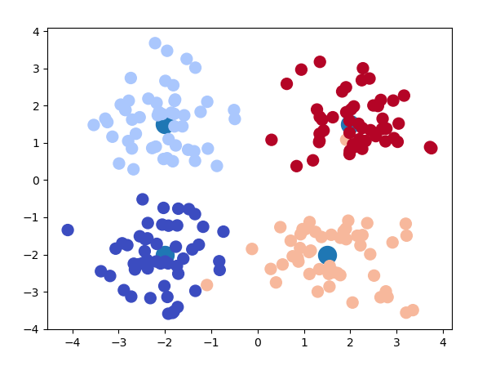

Slide 13
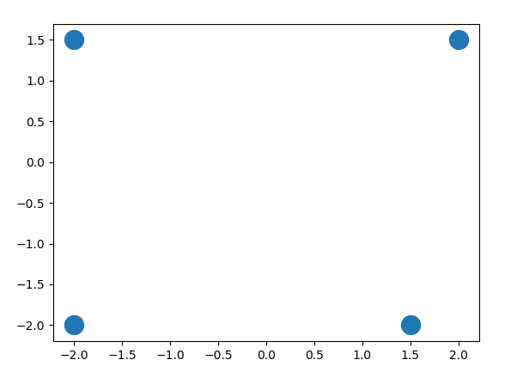

Slide 14
・Implementation
・Using Machine Learning（unsupervised learning）
・Framework : tensorflow
・Window 10
・Python 3.6
・GPU：GTX950

Slide 15
・Using Machine Learning（unsupervised learning）
・Window 10
・Python 3.6
・GPU：GTX950

Slide 16
Supervised Learning：
Training the model with “Labeled”data , which is a common way in implementation
Advantage: Higher precision
Disadvantage: More cost
Unsupervised Learning：
Training with “Un-Labeled” data , common in clustering , but pure unsupervised learning is not common in implementation
Advantage : Less cost

Slide 17
・Algorithm : K-means

Slide 18
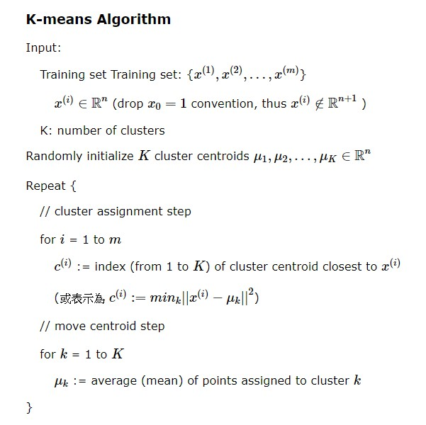

Slide 19
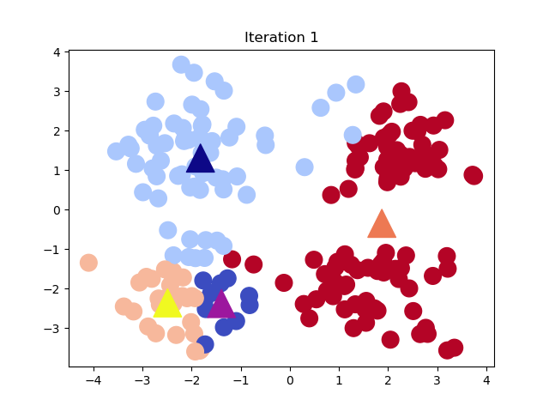
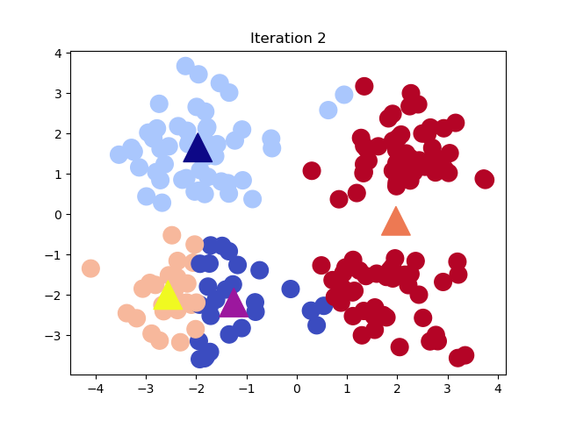

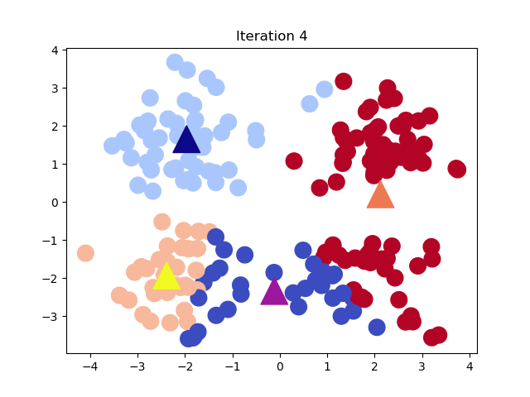

Slide 20
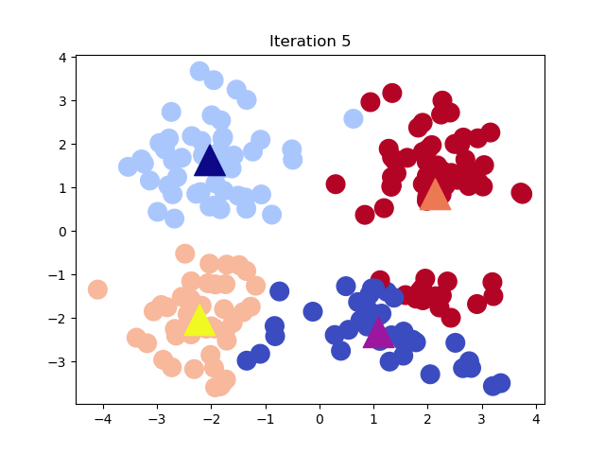
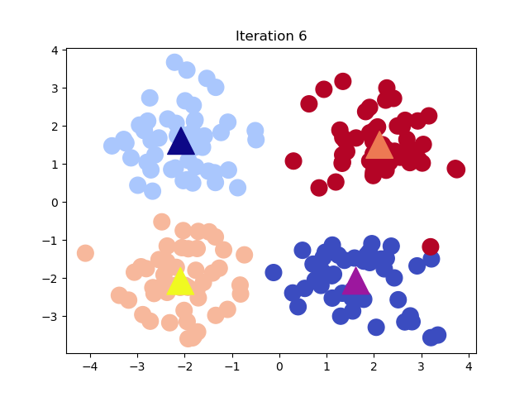



Slide 21
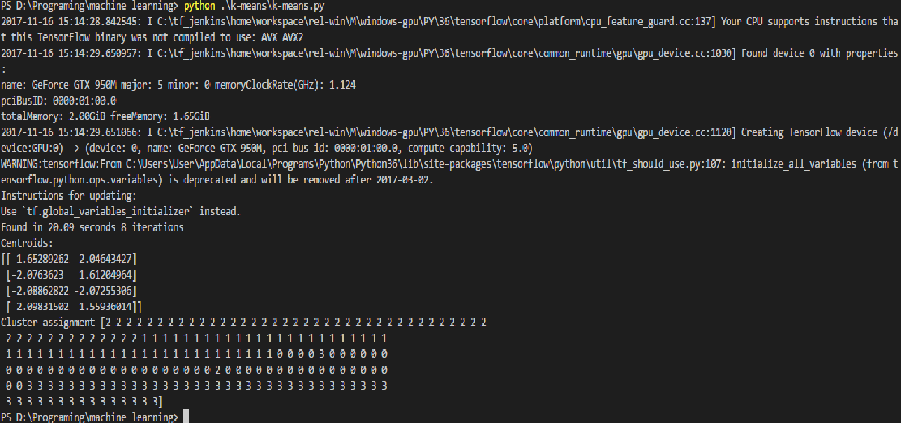

Slide 23
Source Code

Slide 24
Import all we need
import tensorflow as tf
import numpy as np
import time
#help us to graph
import matplotlib
import matplotlib.pyplot as plt
#import datasets we need by scikit-learn
from sklearn.datasets.samples_generator import make_blobs
from sklearn.datasets.samples_generator import make_circles

Slide 25
Set up Data set
#set up data type , here i choose blobs to make it simpler
DATA_TYPE = "blobs"
#Set up Number of clusters in train data , if we choose circle,2 is enough
K = 4
if(DATA_TYPE == "circle"):
K = 2
else:
K = 4

Slide 26
Set up Data set
Using ski-learn
for blobs:
n_samples : number of data , which means we have 200 points
centers = [(-2, -2), (-2, 1.5), (1.5, -2), (2, 1.5)]
centers = centers
n_features = dimmension , here we choose plane so = 2
cluster_std = std
shuffle : if we mix up samples,here I choose false
random_state : random seed
for circles:
noise : random noise data set up to the sample set
factor : the ratio factor between circle data set

Slide 27
Conclusion
Using unsupervised learning takes advantage of Clustering.
As the result , the common way in implenmentation is Clustering first before supervised learnig which called “Semi-supervised learning”
In this case , I choose an easy way to generate a data, and imply unsupervised learning which can help me to Label the data first , considered a pre-handling stage
(different color represent different Lebel)

